Slide 1
Abraham Lincoln, Vampire Hunter
A book analysis by Mabelyn Soto

Slide 2
Important
This book is not about the Civil War. It is the tale of the life and mind of Abraham Lincoln and the mysteries that surround it. It does, however, give an insight to the events leading up to the Civil War and their connections to it.
Title: Abraham Lincoln: Vampire Hunter
Author: Seth Grahame-Smith
Publisher: Grand Central Publishing
Copyright Date: 2010

Slide 3
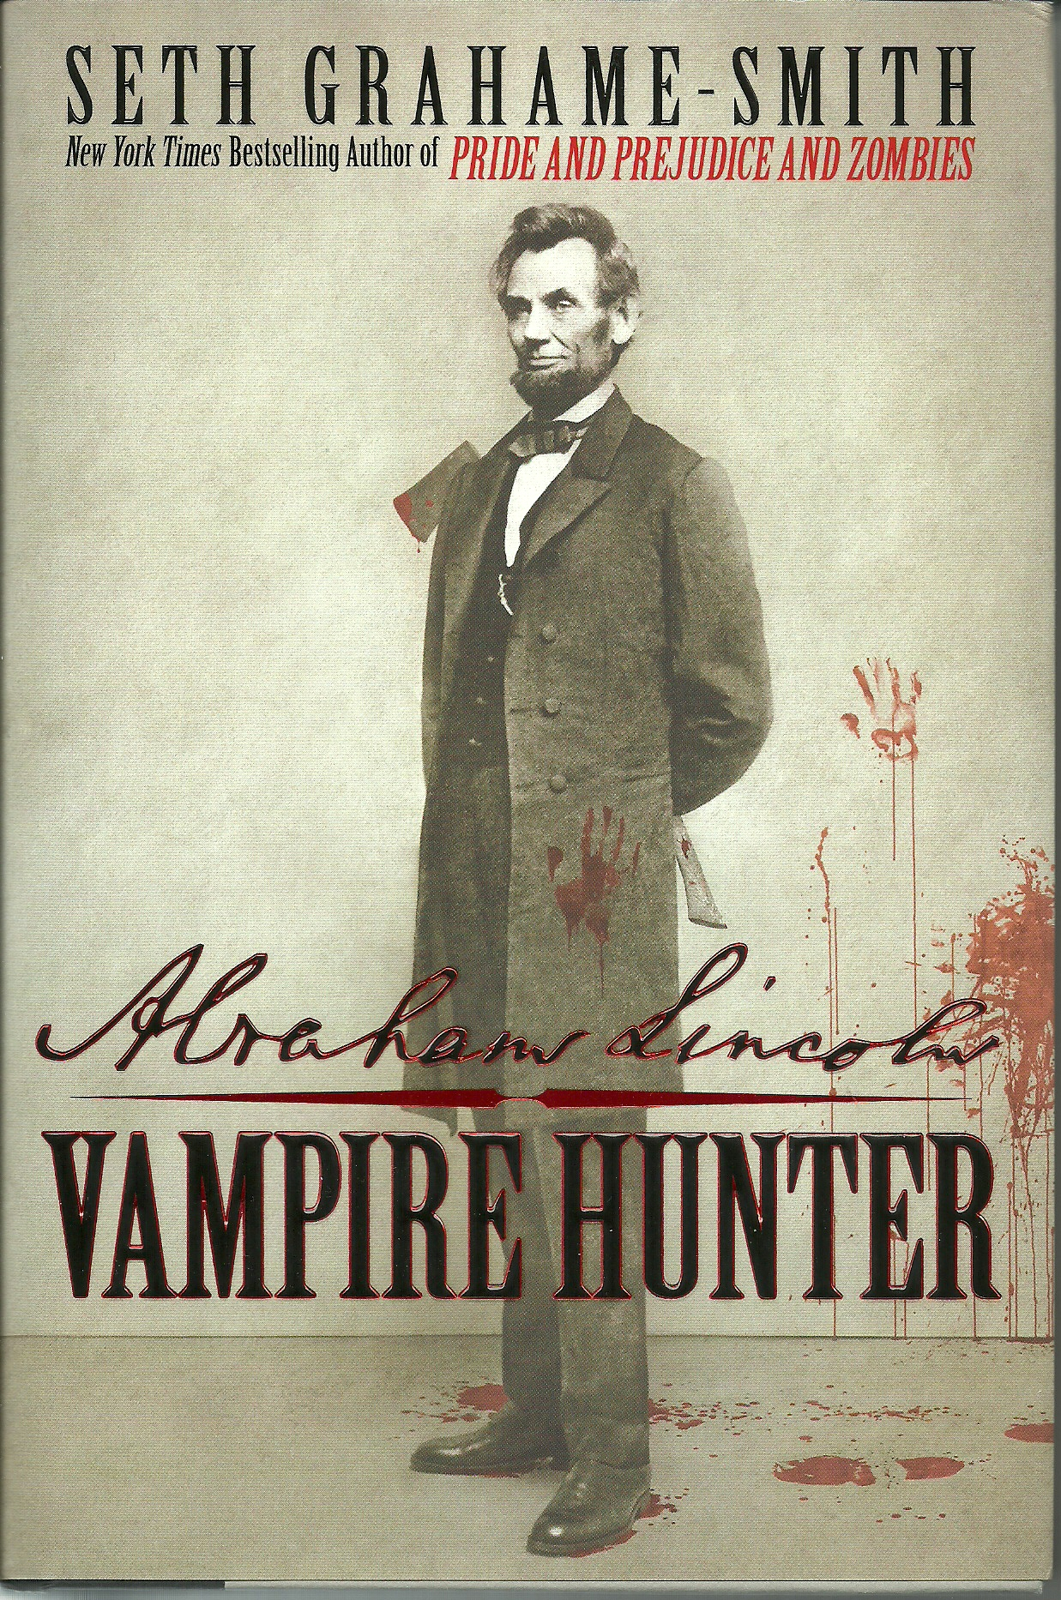
Summary
In short, Abraham Lincoln, Vampire Hunter is the story of a man’s life from the time he is a young boy to the time of his death. This man just happens to be the great Abraham Lincoln, 16th president of the United States of America. However, this isn’t just any common biography of his life. It touches the history of what actually happened and why Lincoln was such the mysterious character. In this twist of your normal uninteresting history class, the truth is unraveled. Vampires exist! Yes, vampires. And they’re everywhere and in every historic event. This novel follows Abraham Lincoln as he seeks vengeance for the his mother’s death by a vampire, his training and friendship with a fellow vampire named Henry Sturges, and his presidency in the midst of a war between vampires and humans (Civil War).

Slide 5
Who was Abraham Lincoln?
What We Know
What We Don’t Know
Vampire Hunter
Suffered many tragedies throughout the course of his life (death of his mom, his first love, his best friend, two sons, etc.)
Suffered from depression and contemplated suicide multiple times
Disliked his father and his home life yet loved his stepmother
Loved books and literature and taught himself everything he knew
Was a lawyer. He taught himself law and passed the bar in 1836 at the age of 27
Former President of the United States (16th)
Went against William H. Seward during the Election of 1860
Abolished slavery
Gave the Emancipation Proclamation and the Gettysburg Address
President during the Civil War

Slide 6
Important Characters

Slide 7
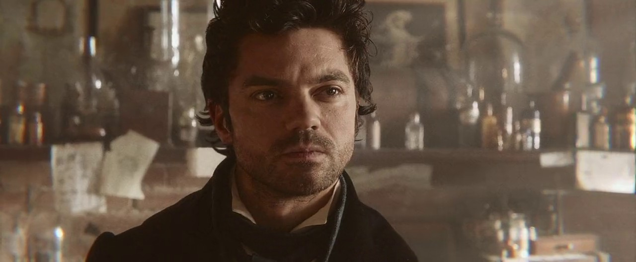
Henry Sturges

Slide 8
Henry Sturges
Henry Sturges is perhaps the most compelling yet enigmatic character in this novel. Henry meets Abraham the day he saves his life. Lincoln had decided to start seeking revenge on the vampires that killed his mother yet he wasn’t skilled enough and almost dies trying on his second attempt. That is until, superhero Henry, professional vampire slayer who also just happens to be a vampire, saves him. Lincoln becomes Henry’s apprentice and a special friendship begins. From Henry, Lincoln learns that not all vampires are bad and/or killers. The reason Henry gives Abraham for hating a part of his fellow species is his knowledge of what it's like to have them ruin your life and he dislikes those vampires who kill without thinking about the people they're killing or the lives they're ruining. Henry teaches Abraham how to be the best hunter/killer of the country in less than two months. Lincoln then sets forth on the adventure of a lifetime as he becomes a politician/ family man by day and vampire hunter by night with Henry frequently sending Abe letters with his next victims.
“It is one thing to feed on the blood of the old and the sick and the treacherous, but quite another to take sleeping children from their beds; quite another to march men and women to their deaths in chains, as you have seen with your own eyes.”
Page 162

Slide 9
Lincoln’s Training with Henry

Slide 10
Jack Armstrong
Joshua M. Speed
Another of Abe’s accomplices, Speed was a unique and incredibly loyal friend to him. Although not as skilled as them, Speed joined Armstrong and Lincoln in vampire hunting and even went by Lincoln’s wishes when he was no longer hunting himself. Although they worked together and had to protect each other’s lifes, Armstrong and Speed did not get along well, but tolerated each other for Lincoln’s sake.
Jack is Abe’s “duplicate”. He’s tall, strong, and loyal as well as thoughtful. Lincoln meets him whilst working at a convenience store in New Salem, Illinois. After beating Jack up for underestimating his strength, Jack and Abe become close friends and fellow vampire hunting buddies. Jack unfortunately dies from hypothermia when Lincoln becomes president .

Slide 11
Minor But Crucial Characters
Edgar Allan Poe
Anne Rutledge
Mary Todd Lincoln
Ward Hill Lamon
Stephen A. Douglas
Jefferson Davis
Abe’s Trinity

Slide 12
Historical Connections

Slide 13
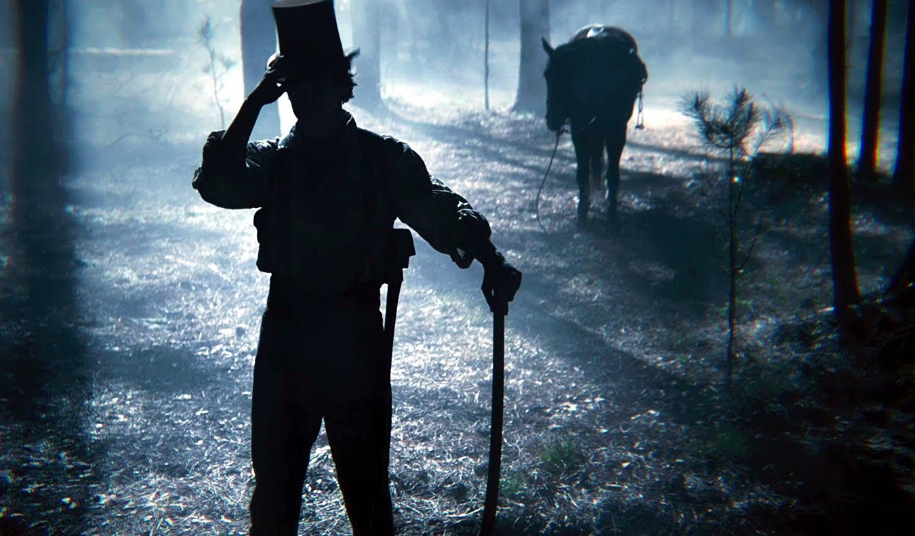
EVERYTHING!
Grahame-Smith takes actual historical mysteries pertaining to the era as an opportunity to make fiction seem believable. The historical connections present throughout this novel are jaw-dropping and too many to count, but here are the most important, yet intriguing ones:

Slide 14
Nancy Lincoln’s death from “Milk Sickness”
What inspires Lincoln to become a vampire hunter is his mother’s death after being attacked by one. Apparently, Lincoln’s father, Thomas owed money to a very rich and powerful vampire whose name was Jack Barts. If Thomas did not clear his debts and pay him his money, he would have to “take it in other ways”. This consequence included the death of his wife, Nancy. This sparked rage in Lincoln and is the reason behind his estranged relationship with his father for the remaining part of his life. In real life, Nancy did die from Milk Sickness when Abraham was only 9. Abraham suffered and blamed his dad for being unsupportive. An excerpt from his journal on the day of his funeral, which Lincoln had chosen to not attend, reads,
“He (Thomas) was an illiterate, indolent man who could not so much as sign his name until instructed by my mother. He had not a scrap of ambition in him… not the slightest interest in bettering his circumstances, or in providing for his family beyond the barest necessities. He never planted a single row more than was needed to keep our bellies from aching, or sought a single penny more than was needed to keep the simplest clothes on our backs.” Page 24

Slide 15
Explanation to what happened to the Lost Colony (Roanoke Colony)
In 1587, John White’s English fleet landed in Roanoke, Virginia to establish what would be the first English colony in the New World. John White left 115 colonists behind, one being his granddaughter Virginia Dare. When he returned from England to check up on the colony, there was not a trace left. The homes, however, were intact and no sign of a struggle was shown. To this day, there is no conclusive evidence as to what happened to the colonists. In the novel, one of the colonists in this colony was Henry Sturges, arriving to start fresh with his pregnant wife. However, the only doctor on the fleet turns out to be a vampire and kills all the colonists except for Henry, turning him, in order to have a companion. This is what sparks Henry’s rage for vampires who unconsciously kill.

Slide 16
Vampires causing all major wars and being the face of Evil
In this novel, vampires are depicted as the cause of all major conflicts and wars, not only in America, but worldwide. It all begins with the story of the Lost Colony as it shows how vampires wanted to colonize America and make it their land after Europe had become extremely dangerous to survive in. They are the cause of the Civil War against humans. They are the cause of the first and second World War (1st and 2nd Vampire Uprising in Europe). They are the Ku Klux Klan. Using slavery as a cover story for the war, vampires form an alliance with slave-holders for easy blood and fight the war on the Confederate side. The actual outnumbering present from the Union’s side (2:1) was explained as the South not needing so many troops since vampires were much stronger and could kill without being affected by any bullets.

Slide 17
Edgar Allan Poe
Edgar Allan Poe’s mysterious life is put to use in this novel. Poe and Lincoln are close friends in this book and first met when they were both eighteen. Poe shows Lincoln the world of slavery/vampires and their friendship becomes lifelong. Poe also teaches Lincoln the origins of vampires. Poe’s real life intriguing death, is portrayed as the work of vampires. Poe and Lincoln had reunited just days before. Poe’s alliance with Lincoln may have caused his death, since Lincoln was a known politician by that time with many enemies, living and dead.
"But Poe wasn't interested in learning about vampires to better hunt them—he wanted to know about the experience of living in darkness, of moving beyond death, so that he could better write about it” Page 71

Slide 18
Historical Accuracies and Inaccuracies

Slide 19
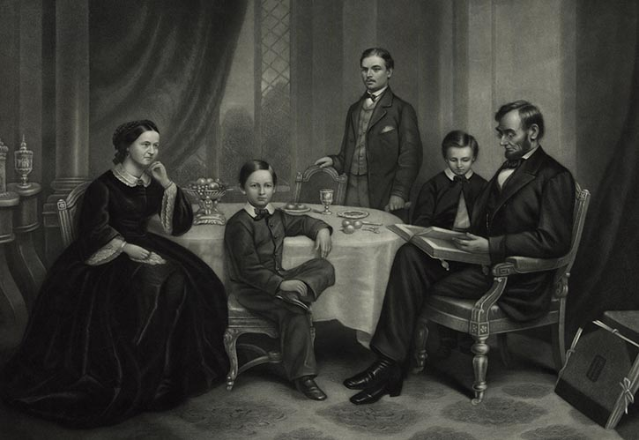
Accuracies

Slide 20
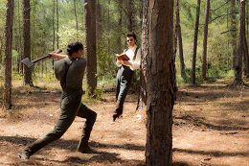
Abraham Lincoln was actually very skilled with his ax
Lincoln’s neighbors in Indiana once recalled, “He can sink an ax deeper into wood than any man I ever saw”, and, “If you heard him felling trees in a clearing, you would say there were three men at work by the way the trees fell.” Throughout the book, Lincoln’s skills with an ax are constantly shown and put to the test. His ax is his weapon of choice, since he has known to use one since he was a young boy.

Slide 21
Deaths
All the deaths in the story are accurate in date and “cover story”.
Nancy Lincoln did die in 1818 when Abe was only 9 from milk sickness.
Anne Rutledge died at 22 from typhoid fever after an epidemic in her town.
Willie Lincoln died at 8 from a fever. Eddie Lincoln died at 3.
Lincoln’s sister Sarah died during childbirth at 24 years of age.
Edgar Allan Poe died on October 7, 1849 and to this day nobody knows what really happened to him.
Abraham Lincoln was killed on April 15, 1865 from a bullet shot wound from John Wilkes Booth.
All these deaths, however, are portrayed as the work of vampires which is fictitious.

Slide 22
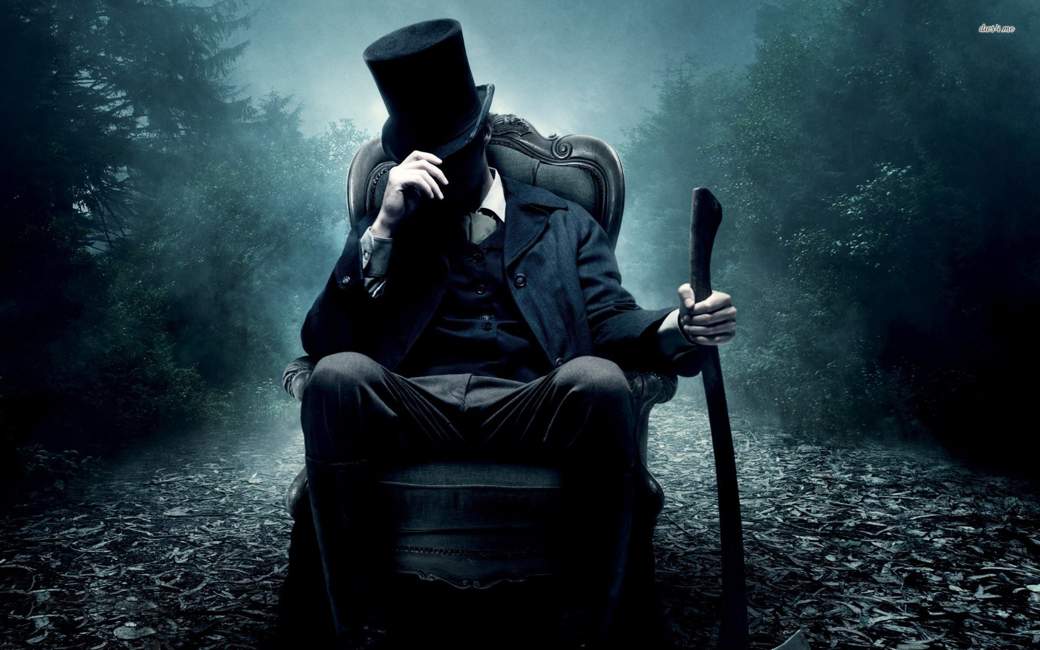
Inaccuracies

Slide 23
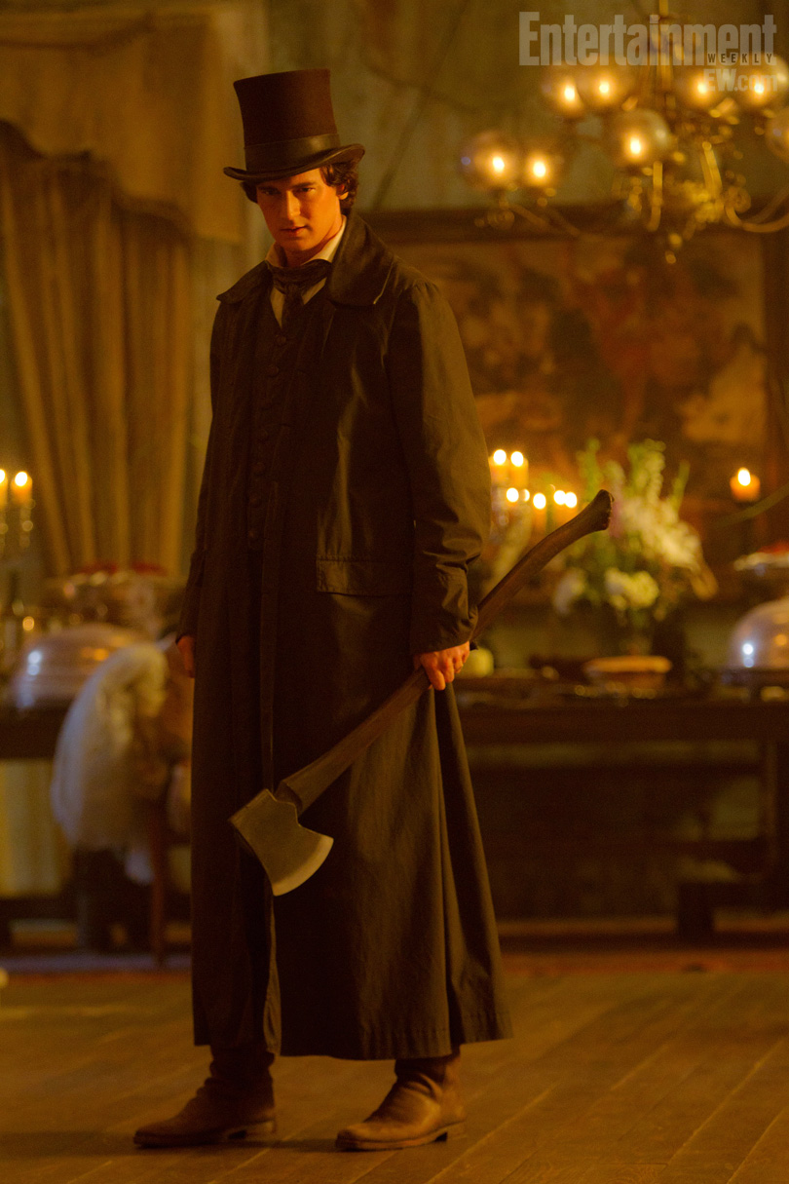
Vampires (Spoiler Alert)
The only plot hole in this novel is the existence of vampires and their involvement in everything. Vampires, although they don’t exist, add a supernatural element to the story, making it much more interesting. The author, however, made the story more than believable with the other connections present and made me question more than once if it were actually possible for vampires to exist. Paranormal entities aside, without the addition of vampires and cool vampire hunting scenes, this tale would be just another boring biography about one of the many presidents that has governed the country.

Slide 24
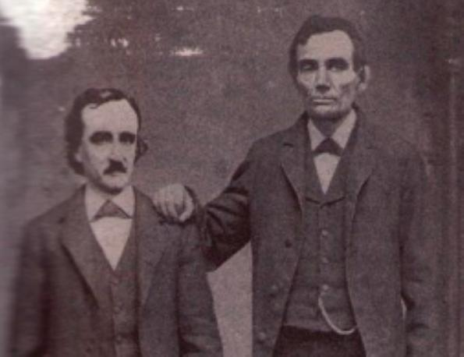
Edgar Allan Poe never met Abraham Lincoln
An interesting connection in this novel is that of Edgar Allan Poe being close friends with Abraham Lincoln. However, and unfortunately this never happened. Although, they were both living in the same era and Lincoln was aware of Poe’s work, they never met in real life. And even if they had, there is no historical record of this meeting. If they did, that would have been an awesome friendship.

Slide 25
Review
I would totally recommend this book to any person who finds history boring, but has to learn it anyway. I personally find historical fiction a bit too tedious and uninteresting, but the addition of vampires and the overall action of this novel made it a lot more bearable and interesting to read.

Slide 26
Movie Trailer

Slide 27
Comprehension Questions

Slide 28
What new knowledge, fiction aside, do we have of Abraham Lincoln?
Name one historical connection that contributes to making this supernatural fiction believable.
What encouraged Lincoln to kill the undead? Why? Who trained him?

Slide 29
Bibliography
Tanya Basu, National Geographic PUBLISHED December 8, 2013. "Have We Found the Lost Colony of Roanoke Island?" National Geographic. National Geographic Society, 8 Dec. 2013. Web. 03 Apr. 2016. <http://news.nationalgeographic.com/news/2013/12/131208-roanoke-lost-colony-discovery-history-raleigh/>.
"Did Lincoln Really Swing a Mean Ax?" About.com Education. N.p., 18 Nov. 2014. Web. 03 Apr. 2016. <http://history1800s.about.com/od/abrahamlincoln/ss/Abe-Lincoln-and-His-Ax.htm>.
Mikkelson, David. "FAKE: Abraham Lincoln Meets Edgar Allan Poe." Snopes. N.p., 21 Jan. 2016. Web. 03 Apr. 2016. <http://www.snopes.com/lincoln-meets-poe/>.
United States. National Park Service. "Facts." National Parks Service. U.S. Department of the Interior, n.d. Web. 03 Apr. 2016. <https://www.nps.gov/civilwar/facts.htm>.
Grahame-Smith, Seth. Abraham Lincoln: Vampire Hunter. New York: Grand Central Pub., 2010. Print.

