Slide 1
Battle of Gettysburg
José Miguel Castillos

Slide 2
Introduction
The Battle of Gettysburg, fought on July 1-3 1863, is considered the most important in all the Civil War. With over 50,000 casualties from both sides it is also the bloodiest in all the Civil War. This battle served as the turning point that eventually brought the Union victory over the Confederacy.

Slide 3
http://civilwarbattles.us/wp-content/uploads/BOG_Total-Casualties_Chart.jpg

Slide 4
Background Info
The general outlook of the Civil War was that The Confederacy was losing heavily on the western front, while on the eastern front, the Army of the Potomac and the Army of North Virginia, led by Robert E. Lee found themselves in a stalemate. In this stalemate even though the South won most of the battles against the North, it lacked the resources to invade the North, so it was always on the defensive.
Things had been like this ever since the start of the war as the mostly rural South was fighting against the heavily industrialized North, which had more men, resources, and infrastructure, while only advantage the South enjoyed was their better generals. The South was set to loose from the start.

Slide 5
The Plan
The planning for the Gettysburg campaign started after the Confederate victory in Chancellorsville, in which Robert E. Lee, again unable to advance, and suffering the loss of his most trusted general, Stonewall Jackson concluded that the only way for a Confederate victory was for him to take the initiative, which meant the fighting was going to take place on his own terms.

Slide 6
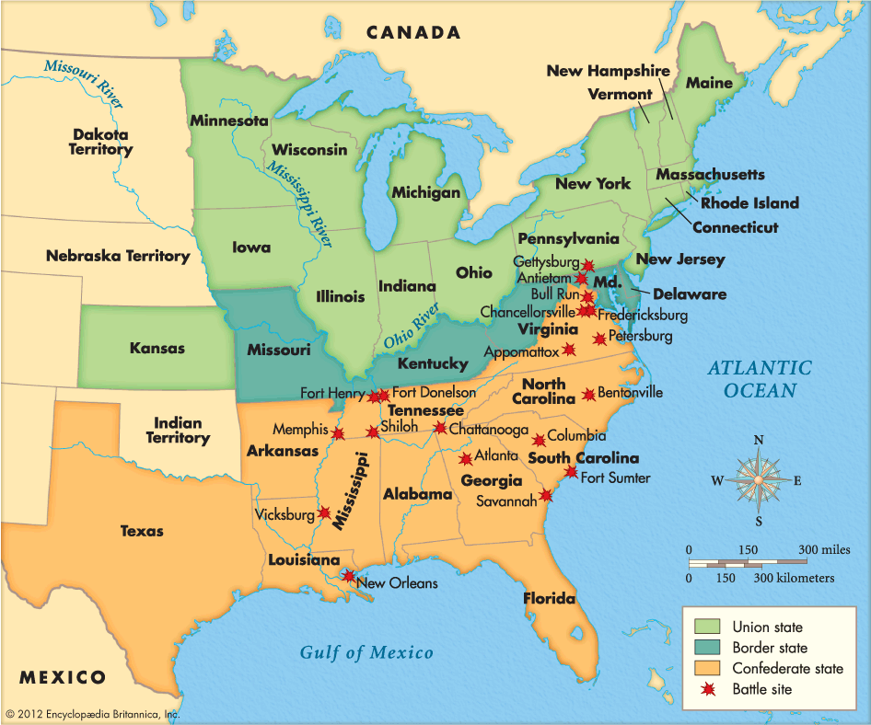
His plan was for an invasion of Pennsylvania, which would function as way to ruin morale to the already demoralized North after loosing many battles, and lure the Army of the Potomac out of Washington, for him to defeat it on his own ground, which would in turn lessen the pressure on the western front and possibly make peace negotiable.
Before the campaign started, Robert E. Lee reorganized his army into three different sections, of which he would take two thirds, which were about 80,000 men, and the remaining third would remain to protect Richmond.
https://encrypted-tbn2.gstatic.com/images?q=tbn:ANd9GcTW1tP5B4Uso-HOtPmmPG5z9PlZ69NFcRrwdmM9cd257wjZaB2SJQ

Slide 7
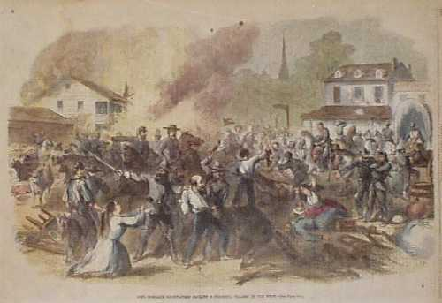
The Invasion
The Confederates, using mountains, valleys, and cavalry protection managed to enter the North unnoticed. At first they invaded the state unopposed easily defeating the local militia and raiding the town’s on their path, by asking for tribute, and paying in Confederate currency, which would only be of use if the Confederacy managed to survive. As they went along they also took every single black they found and sold them into slavery. Eventually the North managed to find them, via spies and scouts the Army of the Potomac marched towards them

Slide 8
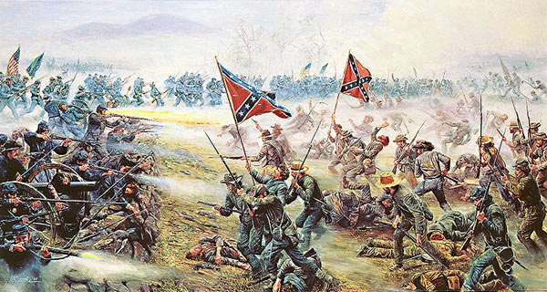
The Battle
As the Federals marched towards them, the Confederates had no idea as they had lost their cavalry, led by J.E.B Stuart, when it got separated of the rest the army along the way leaving the Confederates blind and leaving them at a serious disadvantage in the following battle. When Robert E. Lee finally realized by way of a spy what was to come he quickly reassembled his army at the most convenient spot which was Gettysburg, which coincidentally was were the Northerner’s were marching. On July 1^{st,} 1863 the armies clashed on a meeting engagement that none had planned for.
On the first two days of battle the Confederates won both, although both armies suffered heavily with about 35,000 casualties, however on the third day the Union had regained its position, however Lee thinking his troops had almost won the day before, charged his troops through an open field under command of George Pickett, called the Pickett charge, in which the Rebels were decimated by the Union Soldiers waiting for them. This move destroyed the Confederate army, making them loose the battle on July 3 1863.

Slide 9
The Aftermath
After their defeat the South had lost all hope of ever achieving independence, as its army was devastated and completely demoralized, Robert E. even tried to resign from command, even he wasn’t allowed to. The North on the other hand celebrated their victory and had turned the war on its favor. The following years were about the South trying to stop the inevitable.

Slide 10
Comprehension
Why were the odds always against the South?
Why was the battle of Gettysburg important to the South?
Describe the invasion of Pennsylvania.
How did the outcome affect the war?

Slide 11
Bibliography
Sears, Stephen W. Gettysburg. Boston: Houghton Mifflin, 2003. Print.
History.com Staff. "Battle of Gettysburg." History.com. A&E Television Networks, 01 Jan. 2009. Web. 22 Apr. 2016.

